Slide 1
CS 4530 & CS 5500
Software Engineering
Lesson 12.1: Planning Software Projects
Jonathan Bell, John Boyland, Mitch Wand
Khoury College of Computer Sciences © 2021, released under CC BY-SA
Notes:
Hi, This is Professor Bell. In this week’s lessons, we’ll discuss approaches to productively building software projects in teams. In this first lesson, we’ll focus on techniques to plan and estimate software projects.

Slide 2
Learning Objectives for this Lesson
By the end of this lesson, you should be able to…
Describe how to perform planning and time estimation in an agile model
Understand why agile processes prefer small team sizes

Slide 3
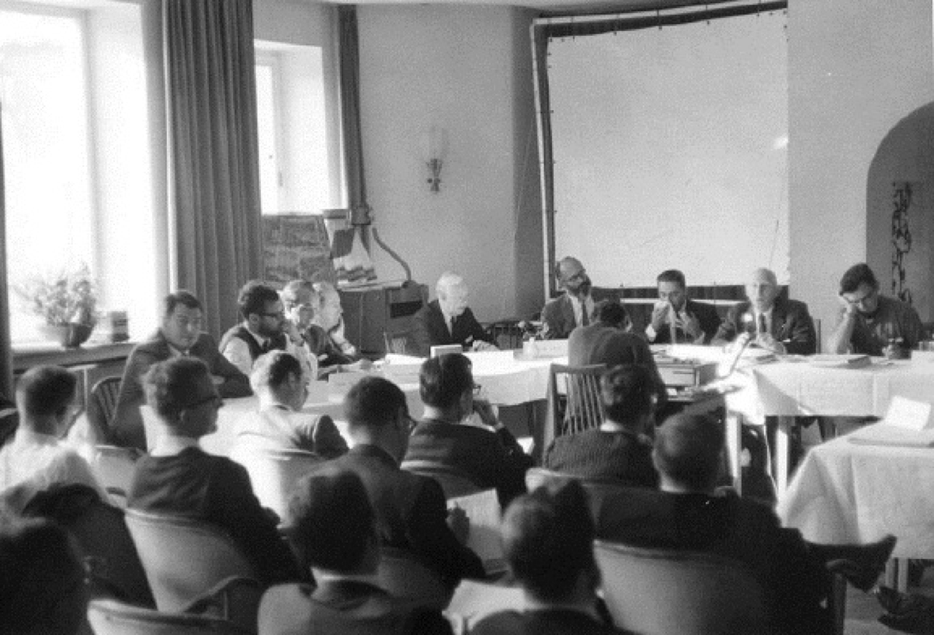
A brief history of software planning
NATO conference on Software Engineering + Outcomes
Software was very inefficient
Software was of low quality
Software often did not meet requirements
Projects were unmanageable and code difficult to maintain
Software was never delivered
A call to action: We must study how to build software
Notes:
Planning software projects is hard, and in fact, the origin of the term and field software engineering is generally considered to have originated from a 1969 NATO conference, where representatives from member countries described the current “software crisis” - that software was often inefficient, low quality, hard to maintain, and sometimes never delivered. The call to action from this report was to discover methods to build software that were as predictable in quality, cost, and time as, for instance, those used to build bridges in civil engineering.

Slide 4
Planning Engineering Projects
In contrast to software projects:
Mechanical in nature
Highly standardized:
Design process
Materials
Construction process
Notes:
With 60 years of hindsight, it’s possible to point out quite clearly some innate differences between planning software projects and planning construction projects. Consider the construction of large buildings like this one: regardless of the purpose of the building and the architectural design of the facade, it’s extremely likely that it will be built like this: first you will dig a foundation, then pour concrete in it. You’ll sink some steel girders into that. Then, you’ll put in a tower crane and repeatedly layer a steel frame going upwards, pouring concrete on each floor. Then, you’ll use the crane to hang a facade - windows or paneling on the outside. Steel and concrete construction companies know exactly how to do this, and the big ones are doing this at multiple sites at the same time in the city. How long will it take? This is a matter of knowing how many floors you need, how many person-hours you have to operate the machinery, and a steady flow of steel and concrete. How do we know if it’s built correctly? We model the loads on the building with empirical data describing the structural properties of the building. Consider this in contrast to software: each project is usually quite different from the last. Knowing how to write a TypeScript method doesn’t tell you how to write all of them, or how to analyze a design to ensure it will work.
Software is not tangible (can’t see it or progress on it, unlike this building)
Unpredictable in terms of complexity, infinitely flexible. Want to reuse, but realistically, lots of different problems come up that are not the same. You might end up seeing similar problems repeated - every business needs some application to track the product that they sell, who they sell it to, and their accounts - but then you become a company like SAP or Salesforce, selling customizations of the same software product.

Slide 5
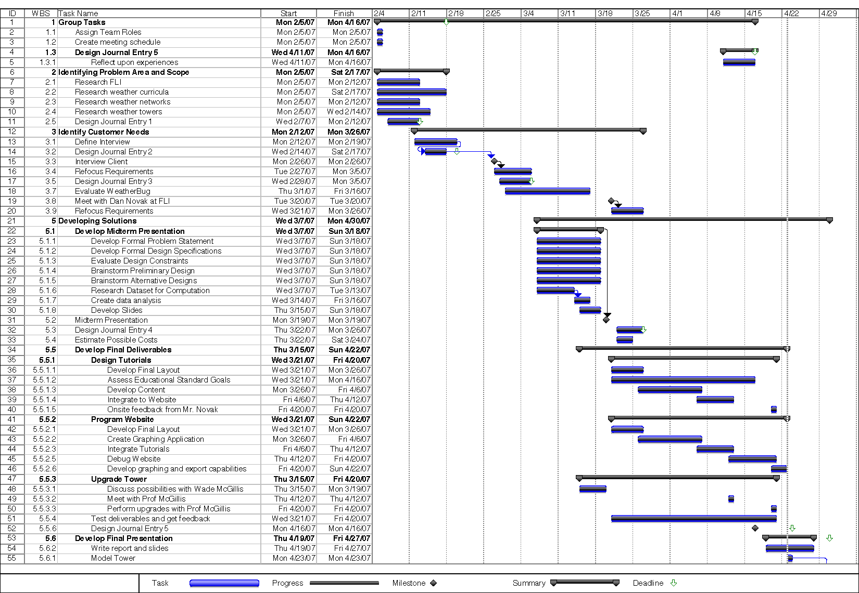
A brief history of software planning
Plan & Document - Gantt Charts
Notes:
Gantt charts are popular in engineering, can be applied in software engineering too, especially in traditional development models (like waterfall or iterative) that put planning upfront - come up with tasks, then estimate hours for tasks, identify dependencies between tasks, and then you know how long it will be. What is problem with this approach?

Slide 6
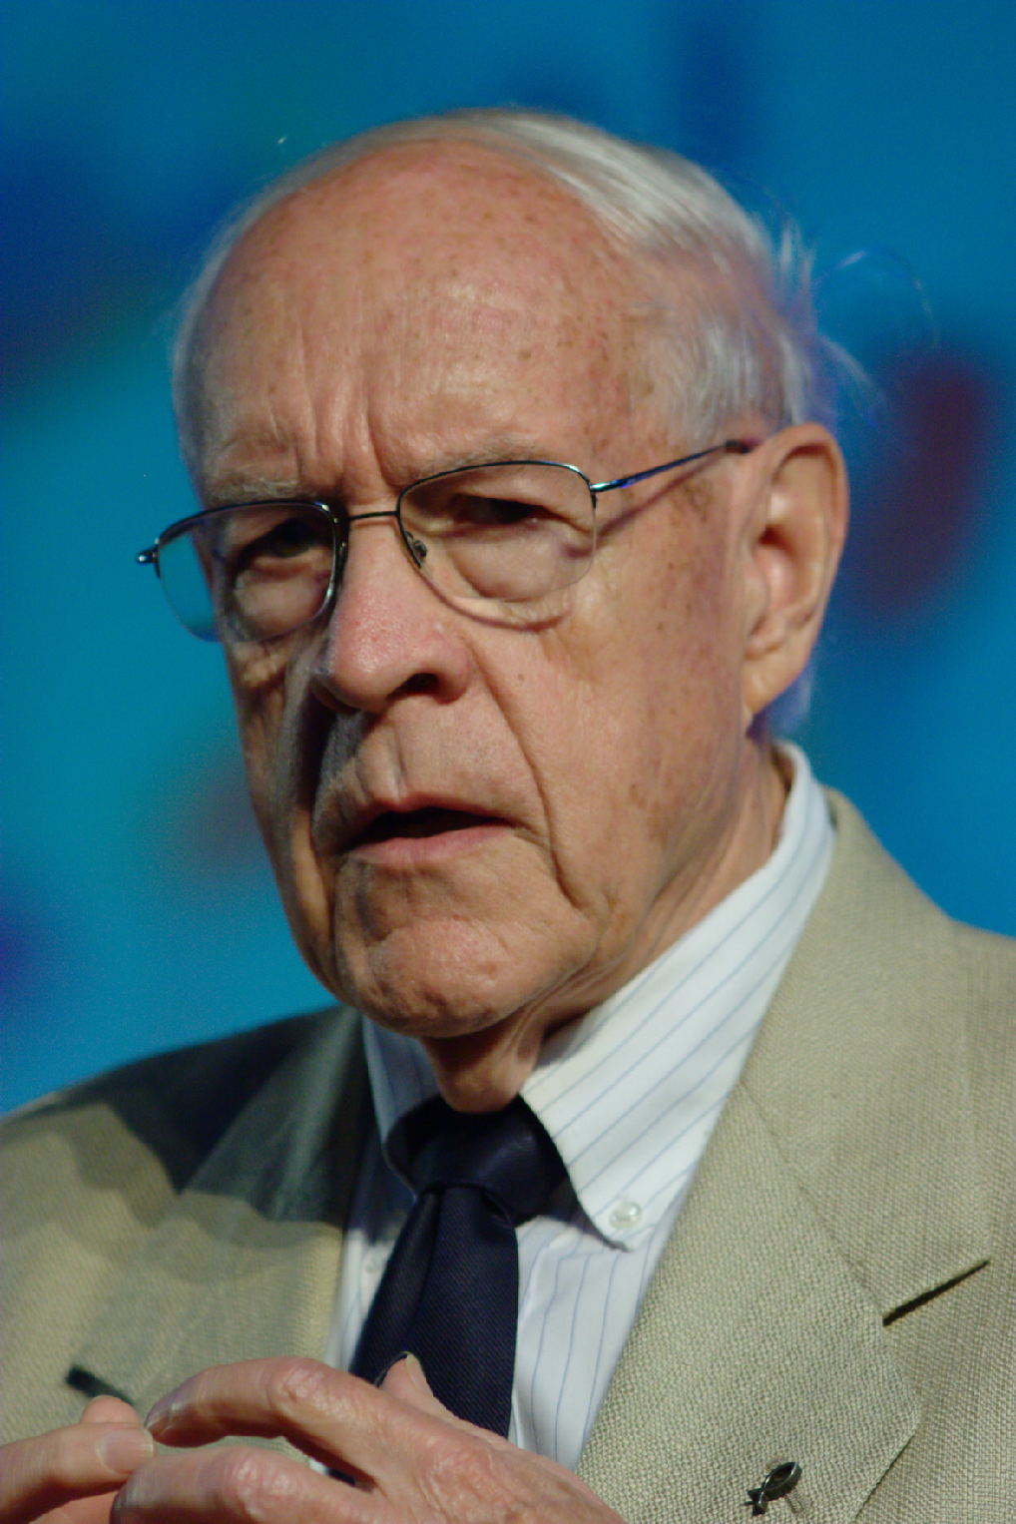
Plan & Document: Problem 1
How do we scale this? The mythical man-month
“Adding manpower to a late software project makes it later”
Fred Brooks, 1975
Notes:
In the 70’s Brooks analyzed software construction failures, coining Brooks’ Law: “Adding manpower to a late software project makes it later.” He talked a lot about the problems that software engineers faced at the time. The core thesis behind his book “The mythical man month” is that it’s a myth to estimate software construction in terms of person-months. This is because complex projects can never be perfectly partitioned into discrete chunks that can be worked on independently. Hence, when adding more team members, you also increase the amount of communication necessary across team members, making your overall development speed slower, not faster. If you’ve been following along in the Software Engineering @ Google book this semester, you have likely found that one of the recurring themes in THAT book is to design processes that scale sub-linearly with the size of your team or the scale of your software: that is, to get around Brooks’ law.

Slide 7
Plan & Document: Problem 2
How long will each task take?
“The management question here, therefore, is not whether to build a pilot system and throw it away. You will do that. The only question is whether to plan in advance to build and throw away, or to promise to deliver the throwaway to customers. Seen this way. the answer is much clearer. Delivering that throwaway to customers buys time, but it does so only at the cost of agony for the user, distraction for the builders while they do the redesign and a bad reputation for the product that the best redesign will find hard to live down.
Hence, plan to throw one away: You will, anyhow.”
Fred Brooks, 1975
Notes:
The second major problem is that it’s notoriously difficult to predict how long a software implementation task will take. Often times, a system is partially designed and implemented, and then thrown away and re-written, since during the construction of that system, the team might learn that they have made some critical mistake. This, combined with the difficulty of estimating how long each of those implementation tasks will take, makes it extremely difficult to predict how long something should take, and to identify when you are falling behind schedule. Another famous quote from the book is: “How does a software project become one year late? One day at a time” - there are often incremental slippages on many fronts.

Slide 8
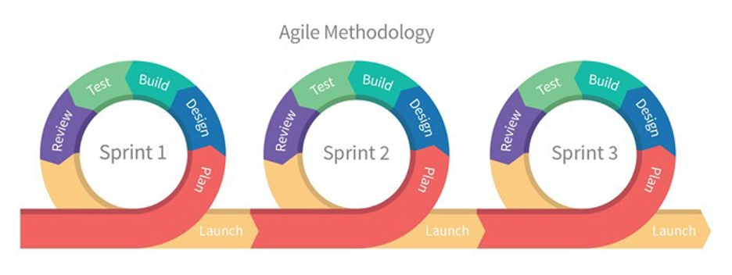
Agile Methodology and Planning
Planning at the per-sprint level
Break down project into sprints
Plan each fixed-length sprint independently, fitting the tasks into the sprints
Key insight: planning might be a guess at first, but gets better with time
Notes:
The agile methodology is a response to these (and other) weaknesses of traditional software planning and development models. In agile…

Slide 9
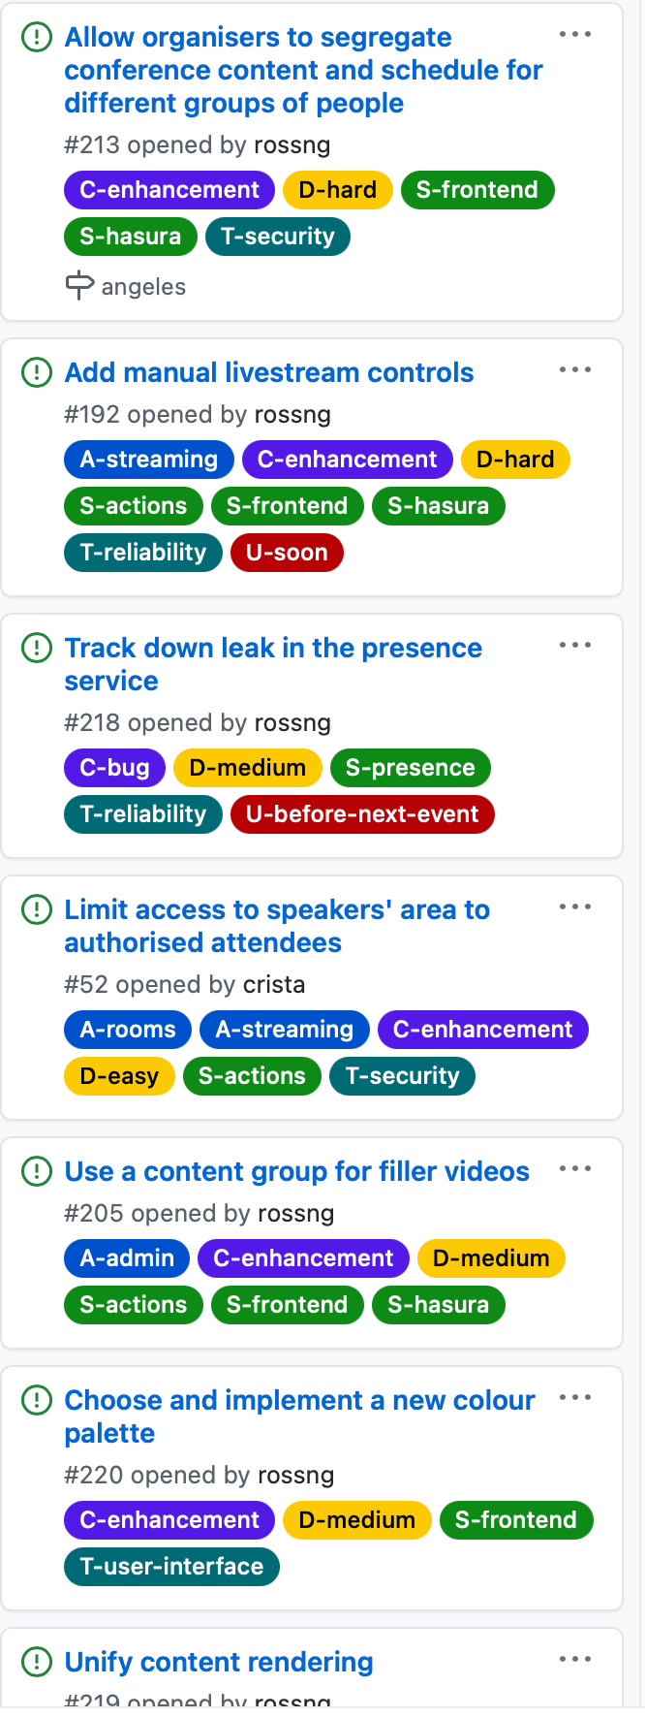
Agile Methodology: The Backlog
Organizing development tasks
Break down big projects into bite-sized chunks
Estimate the duration of each chunk
Create a product backlog (has all chunks), sprint backlogs (plan tasks per-sprint)
Time box sprints: if something doesn’t fit, it goes into next sprint
Focus sprints on business + technical needs
Notes:
On the right, I show a sample project backlog. This backlog includes all of the tasks that need to be accomplished to complete the project, broken down into bite sized chunks. Each chunk (or task) has its own time estimate. The tasks also get assigned to *sprints* - 2-week development windows. The goal is to fit as many tasks into each sprint as will fit based on our estimation of the task’s duration. This approach lets us focus development priorities on business needs (delivering critical or riskier features sooner) and technical needs (delivering shared components on-time to allow other teams to develop other features on top of those shared components). In terms of estimation, a key benefit of this approach is that it provides us with frequent opportunities to check and revise our time estimates: at the start and end of each sprint, we can reflect on the quality of our estimations and perhaps improve future estimates.

Slide 10
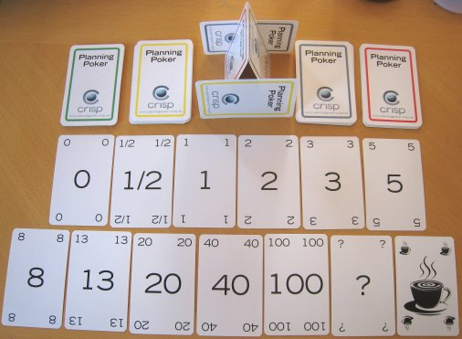
Agile Methodology: Time Estimation
Planning Poker and Story Points
Notes:
Planning poker: each team member plays a card guessing how long it will take, then discuss.
Story points: t-shirt sizes S/M/L
Cut down scope of iteration until it seems like everything can fit.
Recalibrate at end of every iteration: tasks that took half person-day might have taken 2, etc.
If estimates are longer than 8 days, likely that you can/need to break tasks into smaller pieces
This is the approach to handling problem 2 - estimation. How does agile address the other problem in planning - the communication scaling?

Slide 11
Agile Methodology: Communications at Scale
How many links are there between people in your team?
Brooks’ Law: “Adding manpower to a late software project makes it later”
Rationale:
Communication links = n(n-1)/2
Notes:
Agile methodology provides a rationale to Brooks’ law, which helps to consider ways to address this shortcoming.
If you take a small team size of, say, six. That’s 15 links between everyone.
Double that group for a team of 12. That shoots up to 66 links.
A small business of 50 people has an incredible 1,225 links to manage.
The cost of coordinating, communicating, and relating with each other snowballs to such a degree that it lowers individual and team productivity.
This is the rationale for Brooks’ law.

Slide 12
Agile Methodology: Communications at Scale
Non-agile teams
Frontend
Classic teams:
1 team per “tier”
Orders, shipping, catalog
Backend
Orders, shipping, catalog
Database
Orders, shipping, catalog
Notes:
Agile methodology aims to side-step these communications issues by organizing teams differently. Consider this somewhat “classic” organization of developers for an e-commerce site into frontend, backend, and database teams. Now think about what happens as we scale our business up: in addition to needing to have a catalog feature, an ordering feature, and a shipping feature, we might need to have a machine-learning-based product recommendation feature, a streaming media feature, and more. As we add those features to each of the frontend, backend and database teams, we end up in a situation where in the worst case ,all of our developers might need to coordinate with each other: the frontend streaming media developers need to communicate with the backend streaming media developers, perhaps in addition to other frontend developers who work on related features.

Slide 13
Agile Methodology: Communications at Scale
Form “Two pizza” teams
Orders
Example: Amazon
Teams can focus on one business task
And be responsible directly to users
Shipping
“Full Stack”
Catalog
“2 pizza teams”
Notes:
Agile calls for small team sizes, usually 7+-2, or as popularly referred to by amazon, “two pizza” teams - that is to say, when you bring in lunch for your team, you should have few enough team members that 2 pizzas is enough. In this model, each team focuses on a particular business feature, allowing more features to be implemented by creating new teams, allowing for better management of communication between those teams. While you might still need to perform some coordination (like designing a shared API), these tasks can be clearly identified, and then the implementation activities can occur independently.

Slide 14
Delivering on a Deadline
Notes:
How do we know if we will get a rocket to the moon with agile? It’s tricky. Remember that estimation relies on experience: even in the case of constructing buildings (from the start of this lesson), a good estimate only comes from the experience of a project manager and of the on-the-site foreman. Moreover, might make sense to put all of the planning up-front in some high-risk projects, and might still need waterfall. Unfortunately, we have one last Fred Brooks quote to drop in this lesson: “There is no silver bullet - there is no single development, in either technology or management technique, which by itself promises even one order of magnitude [tenfold] improvement within a decade in productivity, in reliability, in simplicity” Next lesson: tracking metrics

Slide 15
This work is licensed under a Creative Commons Attribution-ShareAlike license
This work is licensed under the Creative Commons Attribution-ShareAlike 4.0 International License. To view a copy of this license, visit http://creativecommons.org/licenses/by-sa/4.0/
You are free to:
Share — copy and redistribute the material in any medium or format
Adapt — remix, transform, and build upon the material
for any purpose, even commercially.
Under the following terms:
Attribution — You must give appropriate credit, provide a link to the license, and indicate if changes were made. You may do so in any reasonable manner, but not in any way that suggests the licensor endorses you or your use.
ShareAlike — If you remix, transform, or build upon the material, you must distribute your contributions under the same license as the original.
No additional restrictions — You may not apply legal terms or technological measures that legally restrict others from doing anything the license permits.

